Slide 1
14th IP CONFERENCE – Digital Innovations & Intangible Assets
General Trademark Registration Tactics for a Celebrity in Malaysia & Protection on Non-fungible Tokens (NFT)
by Pui Keng LIM of Advanz Fidelis IP Sdn Bhd
29 July 2022

Slide 2
AGENDA
Part 1: About Advanz Fidelis
Part 2: Laws in Malaysia that Protect Celebrities’ Rights
Part 3: Trademarks Registered by Celebrities
Part 4: Trademark Strategies for Celebrities
Part 5: Celebrities & NFTs
Part 6: How to Avoid Infringing the Rights of others when Creating NFTs
Q & A

Slide 3
Part 1: About Advanz Fidelis

Slide 4



About Advanz Fidelis
Established in the Year 2000
IP Specialists based in Malaysia
Integrating IP & Business
Icons made by Freepik from www.flaticon.com

Slide 5
Our Core Values
AFIP Core Values
Unquenchable Curiosity And A Passion For Innovative Solutions
Integrity And Excellence In Reputation
A “Golden Rule” Working Environment With A Focus On Education
Making Sure End Results Have An Enriching And Beneficial Effect To Our Clients
Communicating Complex Subjects In A Clear And Understandable Manner

Slide 6
Our Approach
Understanding the client & their objectives
Providing perspective & insight, understandable, practical advice
Tailoring the appropriate solution
Achieving a desirable & beneficial outcome
Partnering you in your walk with your client

Slide 7
Our Services
Consultancy
Advisory
Preparatory
IP Management
Legal & Regulatory
Extended Agency Services
Our Services
Corporate IP Development
Representations
Education & Awareness
Mediations
Negotiations

Slide 8




Member of the QANTM Group
Australian public listed company
Comprises 130+ professionals from diverse areas of expertise
Members located in Australia, Singapore, New Zealand, Malaysia

Slide 9







Our Awards
The World's Top 300
Leading IP Strategists
Asia IP – Ranked Firm & IP Expert
The World’s Leading Trademark Professionals
The World’s Leading Patent Professionals
Managing Intellectual Property - Leading Patents and Trademark Firms (Malaysia)

Slide 10
Part 2: Laws in Malaysia that Protect Celebrities’ Rights

Slide 11
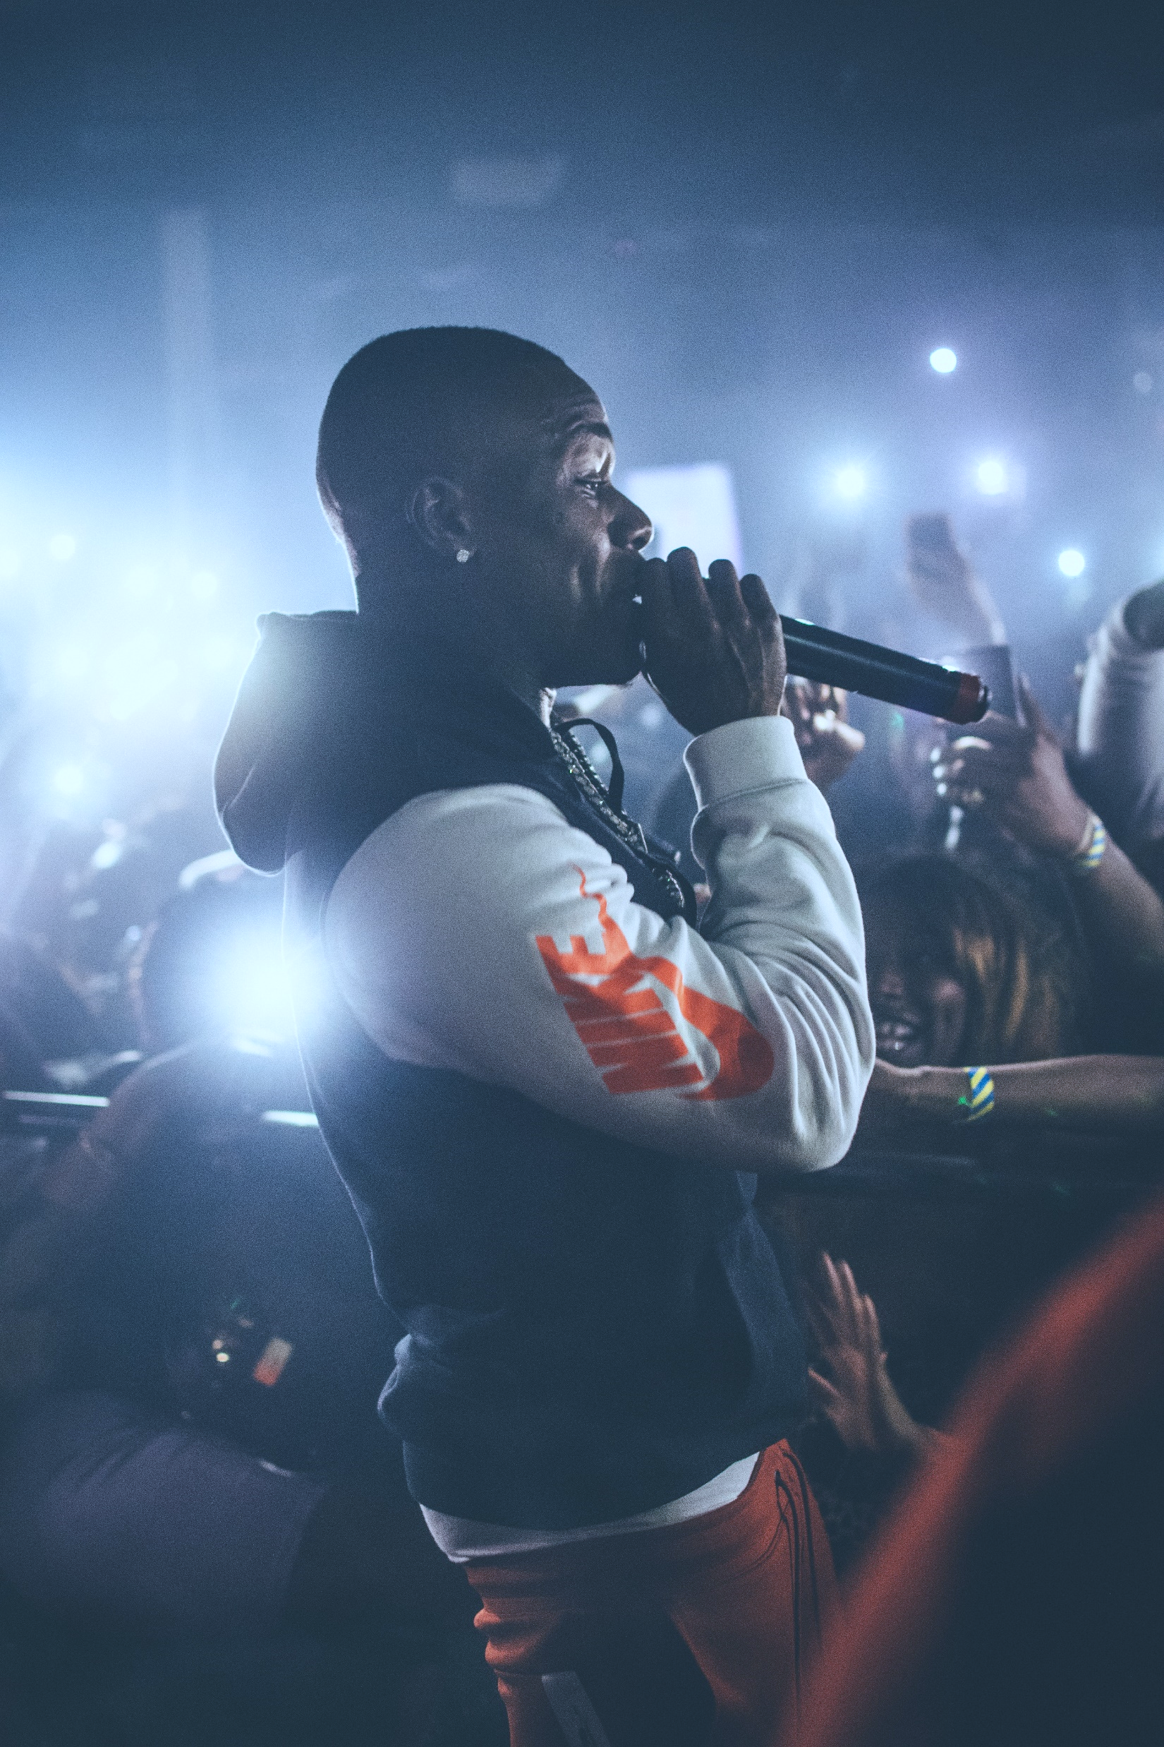



Laws in Malaysia that Protect Celebrities’ Rights
Privacy Rights
Rights to not be exploited
Personality Rights
Rights to protect their likeness (image, voice or other representation) from being used for profit without their permission / appropriate compensation.
3 Celebrity Rights
Publicity Rights
Rights that protects against the misappropriation of a person’s name, likeness or other indicia of personal identity
Image by Zachary DeBottis from www.pexels.com

Slide 12
Laws in Malaysia that Protect Celebrities’ Rights
Fairly robust laws in Malaysia available to protect celebrities’ rights
Though no specific legislation regarding celebrity rights

Slide 13





Laws in Malaysia that Protect Celebrities’ Rights
Copyright Law
Trademark Law
Passing off Law
Protects performer’s rights and image rights
Protects signs registered by celebrities
Protects signs that are not registered as a trademark
Communications & Multimedia Act
Personal Data Protection Act
Protects against unauthorized exposure of information and data on the internet
Protects against invasion of privacy and unauthorized transmission of data

Slide 14

Laws in Malaysia that Protect Celebrities’ Rights
Trademark Law
Most straightforward way to protect name, image and likeness
Protection could be perpetual
Pre-empts abusive attempts by unauthorized third parties

Slide 15
Part 3: Trademarks Registered by Celebrities

Slide 16
Trademarks Registered by Celebrities
Taylor Swift
Jamie Oliver
Registered “Taylor Swift” in Cl 3, 9, 16 & 25
Gordon Ramsay
Ed Sheeran
Registered “Jamie Oliver” in Cl 43
Registered “Gordon Ramsay Bar & Grill” and “Gordon Ramsay Café” in Cl 43
Registered “Ed Sheeran” in Cl 9, 16 & 25

Slide 17
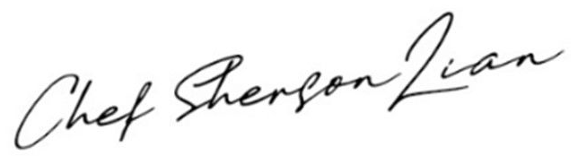

Trademarks Registered by Celebrities
Dato’ Sri Hajah Siti Nurhaliza Tarudin
Chef Sherson Lian
Datuk Lee Chong Wei
Dato’ Sri Hajah Siti Nurhaliza Tarudin
Registered “ ”
in Cl 30, 35 & 43
Singer, actress, businesswoman
Founded cosmetic brand
“ ”
Registered brand in Cl 3 & 35
Registered his initials “LCW” in Cl 16, 28, 35 & 41

Slide 18
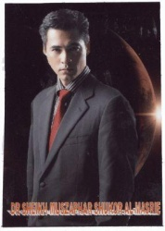
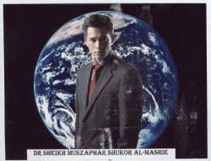
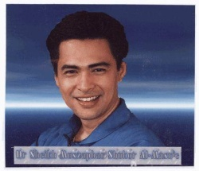
Trademarks Registered by Celebrities
Dato’ Dr. Sheikh Muszaphar Shukor
Malaysia’s first astronaut
Launched merchandise & clothing line
Registered images of himself in Cl 16, 21 & 25 (three marks are as depicted)

Slide 19
Part 4: Trademark Strategies for Celebrities

Slide 20
Trademark Strategies for Celebrities
WHAT IS COMMON AMONGST THE CELEBRITIES?

Slide 21

Trademark Strategies for Celebrities
Understand the importance of trademark
Took action to register it

Slide 22
Trademark Strategies for Celebrities
Under Malaysia’s Trademark Act 2019, the following can be registered:
Letter
Word
Name
Signature
Numeral
Device
Brand
Heading
Label
Ticket
Shape of goods or their packaging
Colour
Sound
Scent
Hologram
Positioning
Sequence of motion

Slide 23


Trademark Strategies for Celebrities
Celebrities should register brands they have developed particularly view a view to commercial goods/services
Advisable to register legal name / stage name / image / stage image or likeness, especially if the name of the celebrity will be / is used as a brand to denote certain goods and/or services, and even though there may not be intention in the near future to commercialise the mark by offering for sale goods or services

Slide 24



Trademark Strategies for Celebrities
Practice consistent policing of unauthorized use of brand, images, photos etc in the market
Keep watch of 3-year “grace period” after which mark is vulnerable to non-use cancellation
Third parties can also register a mark which bares the celebrities’ name, as long as consent is given by the celebrity

Slide 25

Trademark Strategies for Celebrities
Malaysia is a member of Madrid Protocol
The Trademarks Act 2019 has repealed the old Act to statutorily provide for the requirements of Madrid Protocol
More stringent examination: Search and examination are conducted by Trademark Examiners using WIPO’s Global Brand Database and Internet
If a prior mark is disclosed, even if unregistered, pending or registered in another country, refusal based on absolute grounds may be raised against a third party application
A chance that there is still trademark protection even if mark is not registered in Malaysia

Slide 26
Part 5: Celebrities & NFTs

Slide 27
Celebrities & NFTs
Jay Chou
Snoop Dogg
Paris Hilton
Fashion brand “Phantaci” launched a collection of 10,000 “Phanta Bear” NFTs
Sold out in 40 mins
Namewee
One of the few early investors of NFTs
Invested under the pseudonym Cozomo de’ Medici
Amassed wallet worth over $17 million
Launched her own NFT collection
Invested in NFT platform Origin Protocol
Used his songs and images of himself to create NFTs
Made $1.1 million from sales of NFTs
Images from Chinese Music Wiki, Bandwagon Asia, Wikipedia and Mubi

Slide 28
Celebrities & NFTs
Why are celebrities tapping into NFTs?
Enable better control over their work (no middleman in transaction)
Freedom to be creative
Enable better claims for creators on their own works
A new way to connect with fans

Slide 29
Part 6: How to Avoid Infringing the Rights of others when Creating NFTs

Slide 30
How to Avoid Infringing the Rights of others when Creating NFTs
IP rights of the digital assets underlying the NFT belongs to the creator of the NFT, even after the NFT is being sold to another party
Exception: there is a separate agreement between the creator and buyer to license / assign the ownership of the digital assets to the buyer

Slide 31

How to Avoid Infringing the Rights of others when Creating NFTs
Imagine yourself as an NFT creator. You created a video which consists of clips that you have recorded and a background music of a pop song sang by a famous artist.
Do you think you own full rights to the video you have created?

Slide 32
How to Avoid Infringing the Rights of others when Creating NFTs
Important to ensure that the NFT creator owns ALL the IP rights of the digital assets
If the creator does not own ALL IP rights to the digital asset, he/she is not allowed to distribute, commercialize and profit from the asset.

Slide 33
How to Avoid Infringing the Rights of others when Creating NFTs
Celebrities can also register the digital assets as a trademark, provided it fulfills the definition of a “sign” under the Trademark Act 2019.
NFT creators have to ensure they do not infringe upon the rights of celebrities: avoid using celebrities’ work as part of the underlying assets of the NFT without their authorization.

Slide 34
Summary
Robust laws in Malaysia to protect celebrities’ rights
Most straightforward way to protect name, image & likeness of celebrities: Trademark registration
Celebrities should register their brand and legal / stage name / image / likeness as a trademark
Practice constant policing for unauthorized use of brand, images and photos and take action
NFT creators must ensure they own ALL IP rights of the digital assets.

Slide 35

Q & A
Icons made by Freepik from www.flaticon.com

Slide 36
© 2022 Advanz Fidelis IP Sdn Bhd
NOTICE :ALL RIGHTS RESERVED.
All content included in this handout and the presentation on which the handout is based, such as text, visuals, graphics, logos, images, audio clips, digital downloads, data compilations are protected by Malaysian and international copyright laws and belong to various entities. A full reference of the source and ownership of the above is maintained by Advanz Fidelis IP Sdn Bhd (‘Advanz Fidelis’) and can be obtained by written request.
All graphics, logos and images (‘visuals’) are used for illustrative purposes only. Advanz Fidelis makes no representation relating to the same and use of said visuals should in no way be considered as importing any reference or connection between the owners of the said visuals and Advanz Fidelis.
The compilation of all content in this handout and in the presentation on which the handout is based is the exclusive property of Advanz Fidelis.
No part of this handout may be reproduced in any material form (including photocopying or storing it in any medium by electronic means and whether or not transiently or incidentally to some other use of this handout) without the written permission of the copyright owners except in accordance with the provisions of the Copyright Act 1987.
This information contained in this handout is intended to be of a general nature and to address the specific interest of the reader. The information contained herein does not constitute legal or other professional advice or services. Advanz Fidelis assumes no liability for information contained in this handout and disclaims all liability in respect of the information provided herein.
It is important for you to note that the information contained in this handout should not be used as a substitute for a comprehensive consultation with a qualified specialist in the respective field.
We have tried to exercise due care in ensuring that all information contained in this handout has been obtained from what we consider to be reliable sources. However, we make no guarantees as to the accuracy and completeness of any information in the handout. We assume no liability nor responsibility for any errors or omissions or any consequences, damages, costs and/or losses arising from use of the same.
ADVANZ FIDELIS™ is a trademark belonging to Advanz Fidelis and has been applied for and/or registered in Malaysia and overseas. All other trademarks not owned by Advanz Fidelis that appear in this handout and in the presentation on which the handout is based are the property of their respective owners, of which Advanz Fidelis makes no representation as to whether or not such owners are affiliated with, connected to, or in any way commercial deal either directly or indirectly with Advanz Fidelis.

